Slide 1
Troy Hutchison
Service Oriented Architecture (SOA)
Security

Slide 2
SOA
“SOA is a form of technology architecture that adheres to the principles of service-orientation. When realized through the Web services technology platform, SOA establishes the potential to support and promote these principles throughout the business process and automation domains of an enterprise.”
Thomas Erl

Slide 3
What is SOA?
SOA is for building business applications
SOA is a Black-Box component architecture
SOA components are loosely coupled
SOA components are linked together through business processes

Slide 4
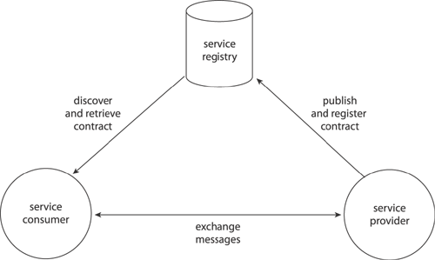
SOA Messaging
UDDI
Access Control
Data Integrity
Auditing
SOAP
SOAP
Privacy
Auditing
WSDL
WSDL
SOAP
Authentication
Authorization and Access Control
Data Integrity
Auditing

Slide 5
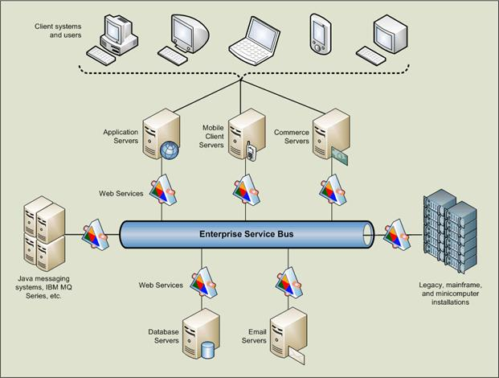
Enterprise Service Bus (ESB)
The Backbone of the SOA infrastructure

Slide 6
SOA security requirements
Heightened security threats
Loosely coupled nature of interaction, requiring flexible ways of handling heterogeneous implementations.
Dynamic interaction between services necessitates dynamic security mechanisms.
Need to reuse existing security mechanisms in distributed systems

Slide 7
Benefits of SOA Design
Increased Interoperability
Increased Federation
Increased Vendor Diversification Options
Increased Business and Technology Domain Alignment
Increased Return on Investment
Increased Organizational Agility
Reduced IT Burden

Slide 8
Questions

